Slide 1

Internet of Things Project using Python (CSE 4110) End-Term Project Presentation on Omni-Directional Bluetooth Controlled Car
Presented by
Mr.Ashwini Kumar Behera
Mr.Ratikanta Sahoo
Mr.Amitosh Mahapatra
Mr. Sushovan Kar
Supervisor
Dr.Hara Prasada Tripathy
Dr. Siddharth Sahany
Department of Computer Science and Engineering
Institute of Technical Education & Research (FET)
Siksha ‘O’ Anusandhan Deemed to be University, Bhubaneswar
January, 2023

Slide 2
Contents
Introduction
Literature Survey
Design Scheme
Testing, Analysis, And Evaluation
Socio-economic Issues Associated With The Project
Engineering Tools And Standards
Conclusion

Slide 3
Introduction
An omni-directional Bluetooth controlled car using IoT (Internet of Things) refers to a vehicle that can be controlled wirelessly via a Bluetooth connection to a device, such as a smartphone or tablet, and can move in any direction. It utilizes IoT technology to allow for remote control and monitoring of the car's movements and other features. This type of car can be used in a variety of applications, such as remote exploration, surveillance, and delivery systems.
An omni-directional Bluetooth controlled car is to provide a convenient and efficient way to remotely control the movement of the car. The omni-directional capabilities of the car allow for greater flexibility and maneuverability, which is useful in tasks that require precise movement and navigation in tight spaces.
Additionally, the Bluetooth control allows for wireless communication between the car and a device such as a smartphone or tablet, making it easy to operate and control the car's movement.

Slide 4
Literature Survey
Research papers and their authors on our topic Omnidirectional Robot.
Name | Author | Date
Design and Implementation of an Omni-Directional Mobile Robot Control System Based on Bluetooth | Jiaxing Wang and Xiaojie Liu | 2016
Development of an Omni-directional Mobile Robot Controlled by Bluetooth | Eun-Cheon Lim, Joon-Ho Lee, and Seung-Woo Lee | 2011
Design and Implementation of an IoT-based Remote Control System for Mobile Robots | Dae-Hee Kim, Seung-Ki Sul, and Byung-Ro Moon | 2018

Slide 5
Design Scheme
Architecture Of Model
Model

Slide 6
Testing
During tests, our proposed model worked as expected. The equipments are tested to the best of our ability.
We could observe accurately what is happening, in our system. There is the App, which helps control the car to move in any direction as per the commands given. we connect our app through Bluetooth and found that we are able to change the direction movements easily through that.

Slide 7
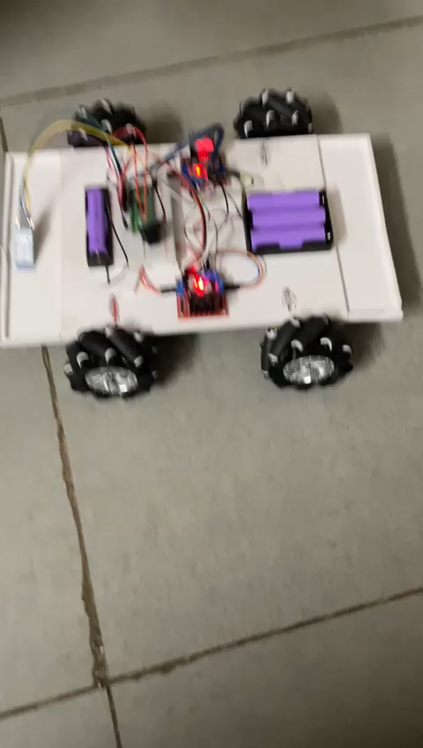

Slide 8
Results, Analysis and Evaluation
The omni-directional Bluetooth controlled car with Bluetooth Remote Control is highly efficient in its movement and control. The mecanum wheel provide excellent traction and stability, allowing the car to move smoothly over 8 directions.
Bluetooth module allows for easy and convenient control, making it easy to maneuver the car in tight spaces or in any direction.
Additionally, the car’s motor provides powerful and precise movement, making it easy to navigate through all the environments.

Slide 9
Socio-economic Issues Associated With The Project
Privacy concerns: As the car is controlled via Bluetooth, there may be concerns about the possibility of unauthorized access and control of the device.
Cost: The cost of the technology and equipment needed to build and operate the car may be prohibitive for some individuals or organizations.
Accessibility: Not everyone may have access to the necessary technology and expertise to build and operate the car, leading to a potential digital divide.
Safety: The robot may pose a risk to people and property if it malfunctions or is operated improperly.

Slide 10
Engineering Tools And Standards
Wires
Glue Gun
Tester and Screw Driver
Paper Cutter
Fevi Gum
Double Sided Tape
Multimeter
Pliers

Slide 11
Conclusion
Creating an omni-directional Bluetooth controlled car requires a combination of mechanical, electrical, and software engineering skills. The car must be designed and built to move in any direction, and must be equipped with a Bluetooth module for remote control.

Slide 12
References
Online tutorials and guides for building a Bluetooth controlled car using Arduino and other microcontrollers: https://www.instructables.com/id/Bluetooth-Controlled-Robotic-Car-Using-Arduino/
The Raspberry Pi website (https://www.raspberrypi.org/) also has a variety of tutorials and information on building projects with the Raspberry Pi, which can be used to control the car via Bluetooth.
The Adafruit website (https://www.adafruit.com/) has a wide range of tutorials and information on building projects with Arduino, Raspberry Pi, and other microcontrollers, as well as a variety of sensors

Slide 13


Slide 14


